Slide 1

Hormonal treatments, contraception & hormone replacement therapy
14.11.2019
Docteur Christian Jamin
Paris - France

Slide 2
CONTRACEPTION

Slide 3
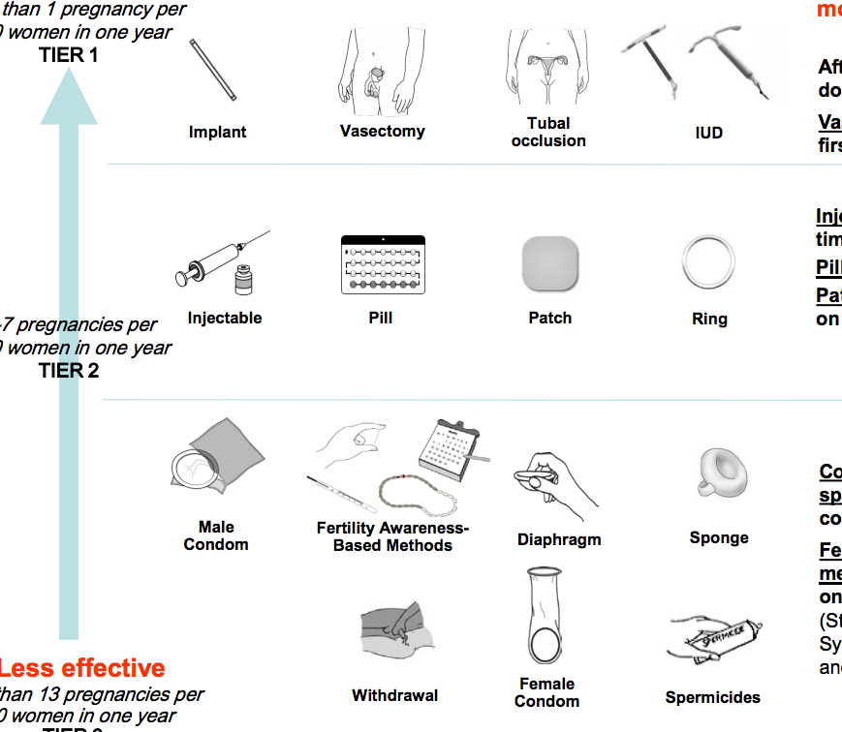
Birth control methods: different effectivenesses ^{(1,2,3)}
MORE EFFECTIVE
HORMONALE METHODS
IRREVERSIBLE METHODS
% of women experiencing
an unintended pregnancy within the first year of use (typical use)
0.05%
0.2-0.8%
HORMONALE METHODS
4%
9%
9%
9%
Diaphragm
or cervical cap
18%
24%
17%
12-24%
(1) http://www.contraceptivetechnology.org/wp-content/uploads/2013/09/Contraception-Effectiveness.pdf ; (2) https://www.cdc.gov/reproductivehealth/contraception/index.htm ; (3) Selected practice recommendations for contraceptive use. Third edition. WHO. 2016.
LESS EFFECTIVE
22%
21%
28%

Slide 4
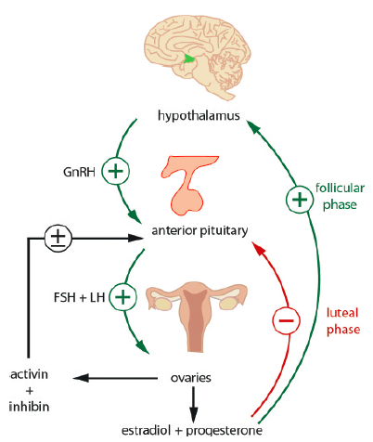
Understanding the hypothalamic-pituitary-ovarian axis
Without contraception ⁽¹⁾
With contraception: Progestogen and oestrogen negative feedback ⁽³⁾
Progestogen
-
-
-
Estrogen
GnRH
LH + FSH
-
Prevention
of ovulation
Stimulation of LH and FSH secretion by pulses of gonadotrophin releasing hormone from the hypothalamus ⁽²⁾
Reduction of LH and FSH secretion by decreasing the frequency of pulses of gonadotrophin releasing hormone ⁽³⁾
(1) McVeigh E. Chapter 8 : Reproductive endocrinology. In K. Coward & D. Wells (Eds.), Textbook of Clinical Embryology 2013. pp. 65-78. ; (2) Berga SL, JohNONnston-MacAnanny EB. Physiology of the menstrual cycle. Chapter 63. Section 8B. Reproductive endocrinology. In: Clinical Gynecology. Cambridge University Press. 2015. pp 972-984. ; (3) Cooper DB et al. Oral contraceptive pills. StatPearls Publishing; 2019.
Notes:
Progestogen negative feedback works at the hypothalamus to decreases the pulse frequency of gonadotropin releasing hormone. This, in turn, will decrease the secretion of FSH and decreases the secretion of LH. If the follicle isn(t developing, then there is no increase in the estradiol levels. The progestogen negative feedback and lack of estrogen positive feedback on LH secretion stop the mid-cycle LH surge. With no follicle developed and no LH surge to release the follicle, there is the prevention of ovulation. Estrogen has some effect with inhibiting follicular development because of its negative feedback on the anterior pituitary with slows FSH secretion.

Slide 5
HORMONALE CONTRACEPTIVE METHODS

Slide 6
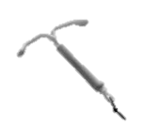

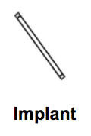
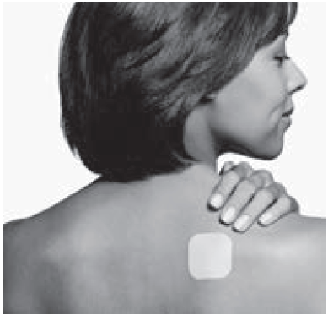
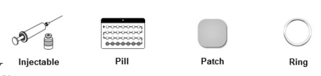
Contraceptives: different methods
LARC
LONG-ACTIVE REVERSIBLE CONTRACEPTION
SARC
SHORT-ACTIVE REVERSIBLE CONTRACEPTION
Hormonal intrauterine devices
(progestin)
Pill
Progestin-only pill
2) Combined oral contraceptives: (progestin + oestrogen)
Copper intrauterine devices
(Non hormonal)
Implant (progestin)
Patch (progestin + oestrogen)
Injection (progestin)
Ring (progestin + oestrogen)

Slide 7
Hormonal contraceptives
LARC – LONG-ACTIVE REVERSIBLE CONTRACEPTION
Hormonal intrauterine devices ^{(1,2)}
Local release of progestin (LEVONORGESTREL = LNG) for 3 to 5 years
Modifying the cervical mucus making sperm unfit for fecundation and preventing implantation
Major contraindications are progestin sensitive cancers (breast cancer) and hepatic disease
Implant ^{(1,2)}
Release of progestin (LEVONORGESTREL or ETONOGESTREL) for 3 to 5 years
Inhibition of ovulation and modification of the cervical mucus
Is not recommended in case of progressive venous thromboembolism
Injection ^{(1,2)}
Every 2 or 3 months: IM or SC injection of progestin (DMPA or NET-EN)
Inhibition of ovulation and modification of the cervical mucus
  Major contraindications are history of thromboembolism or progressive venous thromboembolism
IM: intramuscular ; SC: subcutaneous ; DMPA: medroxyprogesterone acetate ; NET-EN: norethisterone enanthate
(1) HAS. Document de synthèse. Méthodes contraceptives. Focus sur les méthodes les plus efficaces disponibles. Mars 2013. Dernière modification novembre 2017. ;
(2) Family planning. A global handbook for providers. Edition 2018. WHO.

Slide 8
Focus on progestin evolution ^{(1,2,3)}
Hormonal contraceptives
SARC – SHORT-ACTIVE REVERSIBLE CONTRACEPTION
19 Nortestosterone derivatives
Progesterone derivatives
Spironolactone derivatives
1st generation
2nd generation
3rd generation
19-nortestosterone Nandrolone
Norethisterone
Gestoden
Clormadinone Acetate
Drospirenone
Norethisterone Acetate
Desogestrel
Cyproterone
Acetate
Ethisterone
Ethynodiol Acetate
Etonogestrel
Lynestrenol
Medroxyprogesterone Acetate
Levonorgestrel
Nomegestrol acetate
Norgestimate
Norelgestromin
Dienogest
(1) Krattenmacher R. Drospirenone: pharmacology and pharmacokinetics of a unique progestogen. Contraception 2000;62:29-38.
(2) Regidor PA. The clinical relevance of progestogens in hormonal contraception: Present status and future developments. Oncotarget 2018, Vol. 9, (No. 77), pp: 34628-34638
(3) EMA MAA Nomegestrol acetate 26/07/2011.
Notes:
8

Slide 9
Hormonal contraceptives
SARC – SHORT-ACTIVE REVERSIBLE CONTRACEPTION
Progestin only pill (POP); also called the “minipill”
LEVONORGESTREL (LNG) ^{(1,2)}
Low-dose LNG makes the mucus impervious to sperm preventing implantation
Transitory effects:
  Pregnancy risk increases after a 3 hour intake delay
  It has to be taken in a continuous way, without missing any pills and at the same time each day
Amenorrhoea (absence of withdrawal bleeding), but also unexpected bleeding, as with any continuous progestin
DESOGESTREL ^{(1,2,3,4)}
When the dose or the intensity of the progestin is increased there is an inhibition of ovulation which enhances the contraceptive effect
Transitory effects: a 12 hours delay in taking the pill can counteract the anti-ovulatory effect
Unexpected bleedings, acne, hirsutism
DROPIRENONE⁽⁵⁾
October 22, 2019, European Decentralized Procedure (Sweden as RMS) favourable outcome . Marketing Authorization in the coming Months
(1) HAS. Document de synthèse. Méthodes contraceptives. Focus sur les méthodes les plus efficaces disponibles. Mars 2013. Dernière modification novembre 2017. ;
(2) Family planning. A global handbook for providers. Edition 2018. WHO. ; (3) Regidor PA. The clinical relevance of progestogens in hormonal contraception: Present status and future developments. Oncotarget 2018, Vol. 9, (No. 77), pp: 34628-34638. ; (4) Rott H. Birth Control Pills and Thrombotic Risks: Differences of Contraception Methods with and without Estrogen. Hamostaseologie. 2019;39(1):42-48. (5) www.prnewswire.co.uk/news-releases/exeltis

Slide 10
Hormonal contraceptives
SARC – SHORT-ACTIVE REVERSIBLE CONTRACEPTION
Macro progestins and combined hormonal contraceptives (CHC)
Adapted from ⁽¹⁻⁵⁾
Increasing progestin dose blocks follicular development, which allows suspension periods within the cycle
But ovary resting time causes hypo-oestrogenia that needs to be compensated by an intake of oestrogen
=> This becomes an oestroprogestative contraception (combined oestroprogestin contraception)
OESTROGENS (EE or estradiol)
  Improve the inhibition linked to the progestin
  Avoid unexpected bleedings with a better menstrual control depending on the oestrogen dose
  Avoid or reduce hyperandrogenism manifestations: acne, hirsutism
  But also increase the risk of thromboembolism
Adherence is better when women perceive non-contraceptive benefits, i.e., periods being better tolerated, less acne, less facial hair, etc ⁽⁶⁾.
(1) HAS. Document de synthèse. Méthodes contraceptives. Focus sur les méthodes les plus efficaces disponibles. Mars 2013. Dernière modification novembre 2017. ; (2) Family planning. A global handbook for providers. Edition 2018. WHO. ; (3) Regidor PA. The clinical relevance of progestogens in hormonal contraception: Present status and future developments. Oncotarget 2018, Vol. 9, (No. 77), pp: 34628-34638. ; (4) Rott H. Birth Control Pills and Thrombotic Risks: Differences of Contraception Methods with and without Estrogen. Hamostaseologie. 2019;39(1):42-48. ; (5) Chabbert-Buffet N et al. Clinical practice guidelines for contraception of the French National College of Gynecologists and Obstetricians (CNGOF). J Gynecol Obstet Hum Reprod 2019;48(7):441-454. ; (6) Lazorwitz A et al. Does the expectation or perception of noncontraceptive benefits lead to higher rates of short-acting reversible contraceptive continuation for adolescents and young adult women? Contraception 2015;91:380-385.

Slide 11
Hormonal contraceptives
SARC – SHORT-ACTIVE REVERSIBLE CONTRACEPTION
Patch or vaginal ring ^{(1,2,3)}
Release of progestin + oestrogen for 1 (patch) or 3 weeks (ring)
Inhibition of ovulation, modification of the cervical mucus and endometrium
The risk of VTE with the contraceptive patch or ring is THE SAME AS THAT OF THE THIRD-GENERATION CHCs
VTE: venous thromboembolism ; CHC: combined hormonal contraceptives
(1) Family planning. A global handbook for providers. Edition 2018. WHO.; (2) HAS. Document de synthèse. Méthodes contraceptives. Focus sur les méthodes les plus efficaces disponibles. Mars 2013. Dernière modification novembre 2017. ; (3) Chabbert-Buffet N et al. Clinical practice guidelines for contraception of the French National College of Gynecologists and Obstetricians (CNGOF). J Gynecol Obstet Hum Reprod 2019;48(7):441-454.

Slide 12
HORMONAL CONTRACEPTION
& RISK OF THROMBOEMBOLISM

Slide 13

RISK OF THROMBOEMBOLISM
Progestin-only contraceptives
CNGOF GUIDELINES 2018 & 2019
Progestin-only contraceptives*, orally or as implants
or LNG IUDs,
are NOT ASSOCIATED WITH ANY INCREASE IN THE RISK OF VTD,
contrary to progestin-only contraception
with intramuscular (IM) medroxyprogesterone acetate
(RR 2.6, 95% CI 1.8–3.8) ⁽¹⁾
In women at higher vascular risk, progestin-only contraceptives
(administered by oral, sous-cutaneous or intra-uterine routes) can be prescribed ⁽²⁾
The most frequent used: CERAZETTE® (desogestrel 0,075 mg), MICROVAL® (levonorgestrel 0,030 mg) ⁽³⁾
CNGOF: Collège National des Gynécologues et Obstétriciens Français – IM: intramuscular – VTD: venous thromboembolic diseases – LNG IUDs: levonorgestrel intrauterine devices
(1) Chabbert-Buffet N et al. Clinical practice guidelines for contraception of the French National College of Gynecologists and Obstetricians (CNGOF). J Gynecol Obstet Hum Reprod 2019;48(7):441-454. ; (2) Plu-Bureau G et al. Hormonal contraception and vascular risk: CNGOF Contraception Guidelines 2018;46(12):823-833. ; (3) HAS. Document de synthèse. Méthodes contraceptives. Focus sur les méthodes les plus efficaces disponibles. Mars 2013. Dernière modification novembre 2017.

Slide 14
RISK OF THROMBOEMBOLISM
Combined hormonal contraceptives (CHCs)
DO CHCs HAVE AN IMPACT ON HAEMOSTASIS? ⁽¹⁾
Several pro-coagulant changes in blood proteins reported in CHC users ⁽¹⁾
First-pass hepatic metabolism of oral oestrogen leads to increased hepatic synthesis of factor VII, X, and fibrinogen ⁽¹⁾
Women with thrombophilia syndromes have a several-fold increase risk of VTE, therefore, the CDC does not recommend screening for thrombophilias with laboratory testing during routine care ^{(2,3)}
Effects of oral contraceptives on haemostatic parameters. Adapted from (4)
Effects of oral contraceptives on haemostatic parameters. Adapted from (3)
 | SECOND GENERATION ORAL CONTRACEPTIVES | THIRD GENERATION ORAL CONTRACEPTIVES
Procoagulatory factors Prothrombin Fibrinogen F VII F VIII F X | ↑ ↑ ↑ = ↑ | ↑* ↑ ↑* ↑ ↑
Anticoagulatory factors Antithrombin Protein C Protein S APCsr** | = ↑ ↓ ↑ | ↓ ↑ ↓* ↑*
Fibrinolysis TAFI | ↑ | ↑*
* Significant differences between users of second (2nd gen) and third (3rd gen) generation oral contraceptives (p<0.05). ;** APC: activated protein C sensitivity ratio
CDC: Centers for Disease Control and Prevention ; (1) Trenor CC et al. Hormonal Contraception and Thrombotic Risk: A Multidisciplinary Approach. PEDIATRICS 2011;127:347-357. ; (2) Plu-Bureau G et al. Hormonal contraception and vascular risk: CNGOF Contraception Guidelines 2018;46(12):823-833 ; (3) Practice Committee of the American Society for Reproductive Medicine. Combined hormonal contraception and the risk of venous thromboembolism: a guideline. Fertil Steril 2017;107(1):43-51. 4) Tchaikovski SN, Rosing J. Mechanisms of Estrogen-Induced Venous Thromboembolism. Thrombosis Research 2010;126:5–11.
Notes:
Sous pilules Augmentation des facteurs de coagulation. En reaction il y a activation des facteurs anticoagulants
Sous pilule il y a une augmentation de la resistance à la proteine C reactive
En terme de timing il y d’abord augmentation des facteurs de coagulations avant d’avoir un requilibrage avedc facteur anticoagulant Duau decallage d’induction enzymatique
C’est pour cela que e risque de thrombose est majorée les 6 premiers mois à 1 an Attention Quand on arrete la pilule meme si on a prtis longtemps la pil et si on reprend le risque redevient comme pour pour la premiere fois car d’abord augmentation des facteurs de coagulation

Slide 15
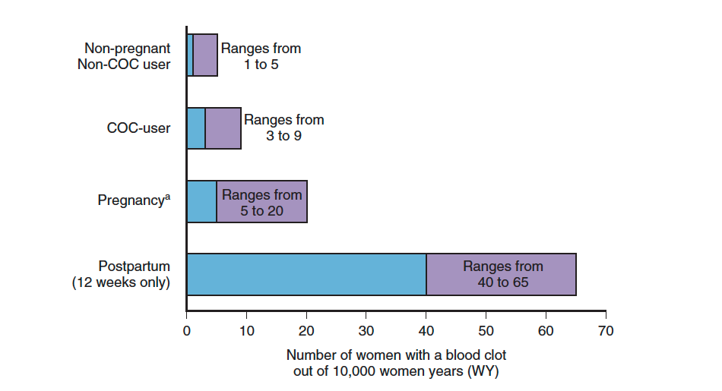
RISK OF THROMBOEMBOLISM
Combined hormonal contraceptives (CHCs)
HOW MANY VTEs ARE ATTRIBUABLE TO CHCs? ⁽¹⁾
CHC-user
ª Pregnancy data based on actual duration of pregnancy in the reference studies. Based on a model assumption that pregnancy duration is 9 months, the rate is 7 to 27 per 10,000 WY.
VTE: Venous ThromboEmbolism
(1) https://www.acog.org/Clinical-Guidance-and-Publications/Committee-Opinions/Committee-on-Gynecologic-Practice/Risk-of-Venous-Thromboembolism?IsMobileSet=false, consulté le 28/10/2019

Slide 16
RISK OF THROMBOEMBOLISM
Combined hormonal contraceptives (CHCs)
WHAT IS THE RISK?
CHC use increases
the risk of VTE ⁽¹⁾
Risk x3 to x6
vs. non-users of CHC
With a starter effect ⁽¹⁾
The risk is
highest during
the first year of use
VTE: venous thromboembolic diseases.
(1) Plu-Bureau G et al. Hormonal contraception and vascular risk: CNGOF Contraception Guidelines 2018;46(12):823-833.

Slide 17
RISK OF THROMBOEMBOLISM
Combined hormonal contraceptives (CHCs)
WHAT DOES THE INCREASING RISK DEPEND ON?
The associated risk factors
The EE dose ⁽¹⁾
The specific progestin use ⁽¹⁾
EE: ethinylestradiol
(1) Chabbert-Buffet N et al. Clinical practice guidelines for contraception of the French National College of Gynecologists and Obstetricians (CNGOF). J Gynecol Obstet Hum Reprod 2019;48(7):441-454.

Slide 18
RISK OF THROMBOEMBOLISM
Combined hormonal contraceptives (CHCs)
=> IMPACT OF RISK FACTORS (RF) ON VTE RISK
300
0 RF
1 RF
2 RF
3 RF
271
200
216
171
VTE/10,000 WY
137
100
105
111
50
53
4
21
27
18
No RF
Obesity
(BMI 30+)
Age 40+
Family
history of VTE
Personal history of VTE *
Pre
existing cancer
BMI 30+
Age 40+
BMI 25+
VTE history **
BMI 30+
VTE history **
Age 40+
VTE history **
BMI 25+
Age 40+
VTE history **
BMI 30+
Age 40+
VTE history **
VTE: venous thromboembolic diseases ; * First Grade relative ;
(1) From Dinger 2011. Oral presentation

Slide 19
RISK OF THROMBOEMBOLISM
Combined hormonal contraceptives (CHCs)
=> THE RISK DEPENDS ON THE EE DOSE
High-dose combined oral contraception (> 50 µg) is associated with higher risks of VTE than lower-dose formulations ⁽¹⁾
There is no reliable evidence that EE doses lower than 35 µg have a lower VTE risk than 35 µg formulations ⁽¹⁾
CHC with 50 µg of EE and levonorgestrel | OR: 5.2 (3.4-7.9) ⁽²⁾
CHC with 20 µg of EE and levonorgestrel | OR: 2.2 (1.3-3.6) ⁽²⁾
CHC with 30 µg of EE and levonorgestrel | OR: 2.4 (1.8-3.2) ⁽²⁾
RISK X 2 ⁽³⁾
VTE: venous thromboembolic diseases – EE: ethinylestradiol.
(1) Practice Committee of the American Society for Reproductive Medicine. Combined hormonal contraception and the risk of venous thromboembolism: a guideline. Fertil Steril 2017;107(1):43-51. ; (2) Plu-Bureau G et al. Hormonal contraception and vascular risk: CNGOF Contraception Guidelines 2018;46(12):823-833 ; (3) Chabbert-Buffet N et al. Clinical practice guidelines for contraception of the French National College of Gynecologists and Obstetricians (CNGOF). J Gynecol Obstet Hum Reprod 2019;48(7):441-454.

Slide 20
RISK OF THROMBOEMBOLISM
Combined hormonal contraceptives (CHCs)
=> THE RISK DEPENDS ON THE SPECIFIC PROGESTIN USE
Specific risk of developing a blood clot (VTE) in a year ⁽¹⁻⁴⁾
19 Nortestosterone derivatives
Progesterone derivatives
Spironolactone derivatives
1st generation
2nd generation
3rd generation
19-nortestosterone Nandrolone
Norethisterone*
Gestodene
Chlormadinone Acetate
Drospirenone
Norethisterone Acetate
Desogestrel
Not yet known ⁽³⁾
About 13
out of 10,000 women ⁽⁴⁾
Ethisterone
Ethynodiol Acetate
About 15
out of 10,000 women ⁽⁴⁾
Lynestrenol
Cyproterone
Acetate
Levonorgestrel*
About 13
out of 10,000 women ⁽⁴⁾
Norgestimate*
“The risk difference between generations
is estimated to be
3/10 000 WY” (adapted from (4))
Norelgestromin**
* About 5-7
out of 10,000 women ⁽³⁾
Etonogestrel**
Medroxyprogesterone Acetate
** About 6-12
out of 10,000 women ⁽³⁾
Dienogest
Not yet known ⁽³⁾
(1) Krattenmacher R. Drospirenone: pharmacology and pharmacokinetics of a unique progestogen. Contraception 2000;62:29-38. ; (2) Regidor PA. The clinical relevance of progestogens in hormonal contraception: Present status and future developments. Oncotarget 2018, Vol. 9, (No. 77), pp: 34628-34638. ; (3) CHMP. Benefits of combined hormonal contraceptives (CHCs) continue to outweigh risks – CHMP endorses PRAC recommendation. Press Release 22/11/2013. ;
(4) Martinez F et al. Venous and pulmonary thromboembolism and combined hormonal contraceptives. Systematic review and meta-analysis.Eur J Contracep Reproduc HealthCare 2012;17:7-29.

Slide 21
CONTRACEPTION
IN AUTOIMMUNE DISEASE
  - Rheumatoid arthritis and psoriatic arthritis
  - IBD

Slide 22
What about the contraception methods used by women with rheumatoid arthritis (RA) and psoriatic arthritis (PsA)?
Some women with RA have unmet contraceptive needs ⁽¹⁾
And 7 of 8 women using no contraception had not discussed contraception with their rheumatologist ⁽²⁾
Among approximately 2,500 reproductive-age women with RA and other rheumatic diseases
32%
were prescribed contraception
over a 2-year timeframe
Compared to
43%
of US women in population-based studies using prescription contraception
(1) Hunt N, Birru Talabi M. Family Planning and Rheumatoid Arthritis. Curr Rheumatol Rep 2019;21(5):16.
(2) Leverenz DL et al. Contraception methods used by women with rheumatoid arthritis and psoriatic arthritis. Clin Rheumatol 2019;38(4):1207-1212.

Slide 23
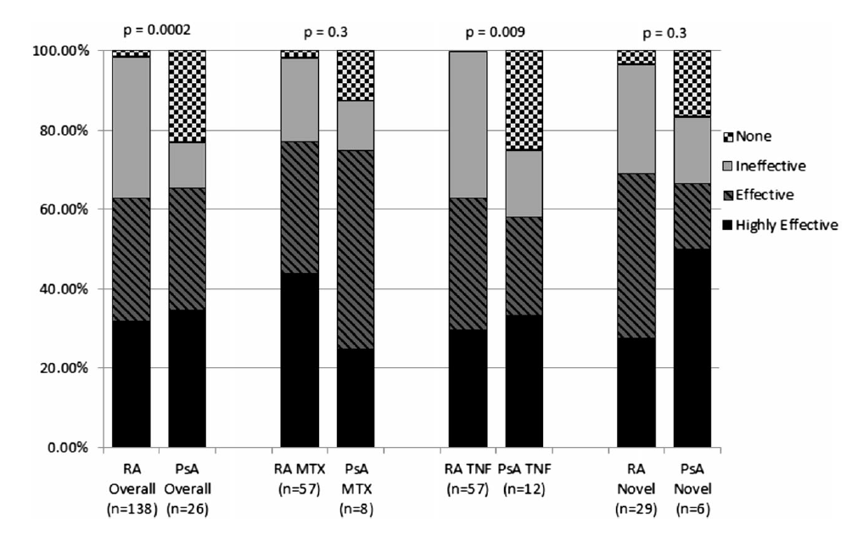
What about the contraception methods used by women with RA and PsA?
The highest rate of effective and highly effective contraception method use was found in women on methotrexate ⁽¹⁾
Contraception methods in RA and PsA patients.
MTX: methotrexate.
Ineffective methods: barrier, rhythm, withdrawal, abstinence.
Effective methods: oral contraceptives, patches, rings, depot medroxyprogesterone.
Highly effective methods: tubal ligation, vasectomy, intrauterine devices, and implants.
RA and PsA novel: patients taking abatacept, apremilast, rituximab, tocilizumab, tofacitinib, secukinumab, and ustekinumab
(1) Leverenz DL et al. Contraception methods used by women with rheumatoid arthritis and psoriatic arthritis. Clin Rheumatol 2019;38(4):1207-1212.

Slide 24

What about the contraception methods used by women with RA and PsA?
Hormonal contraception is not consistently associated with increased or decreased RA activity in studies ⁽¹⁾
Progestin-only pills and sub-dermal implants are safe to use without restriction in women with RA ⁽¹⁾
Rheumatologists have an opportunity
to positively impact pregnancy outcomes
for their patients ⁽²⁾
(1) Hunt N, Birru Talabi M. Family Planning and Rheumatoid Arthritis. Curr Rheumatol Rep 2019;21(5):16.
(2) Leverenz DL et al. Contraception methods used by women with rheumatoid arthritis and psoriatic arthritis. Clin Rheumatol 2019;38(4):1207-1212.

Slide 25

What about the contraception methods used by women with inflammatory bowel disease (IBD)?
Recent literature suggests that women with IBD seek counselling about contraception from GASTROENTEROLOGISTS RATHER THAN from their primary care physicians ⁽¹⁾
23%
of women with IBD of childbearing age reported
not using any form of contraception ⁽¹⁾
only 17%
reported using highly effective methods such as an intrauterine contraceptive device ⁽¹⁾
VTE: venous thromboembolism.
(1) Limdi JK et al. Contraception, Venous Thromboembolism, and Inflammatory Bowel Disease: What Clinicians (and Patients) Should Know. Inflamm Bowel Dis 2019.pii: izz025.

Slide 26
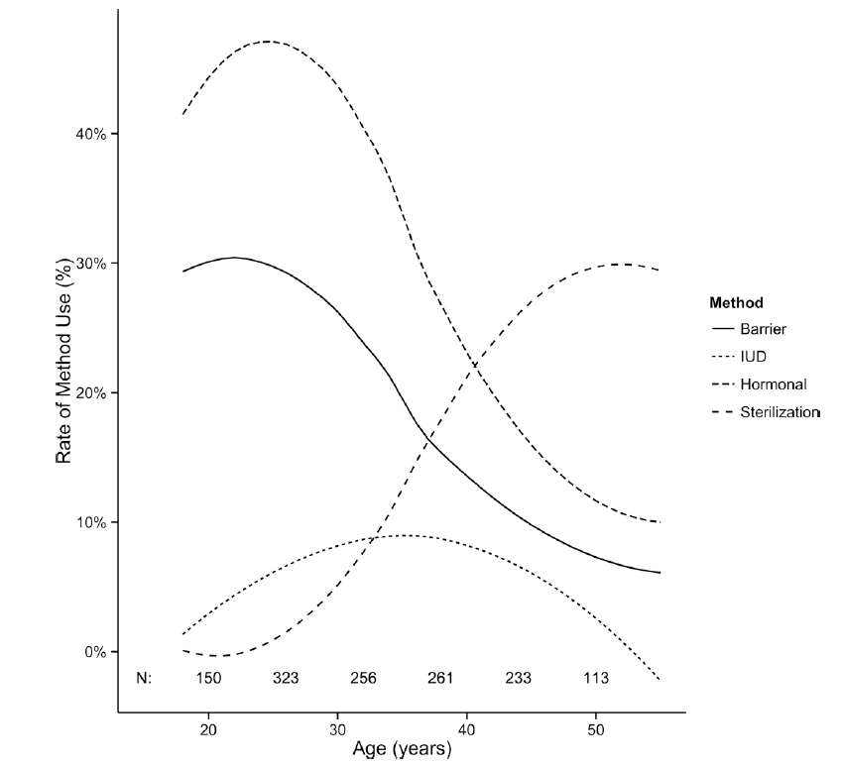
What about the contraception methods used by women with IBD?
Trends in birth control methods by age of respondent among 1,340 women with ULCERATIVE COLITIS or CROHN’S DISEASE among patients at risk for using contraception (USA) ⁽¹⁾
(1) Cotton CC et al. Hormonal Contraception Use is Common Among Patients with Inflammatory Bowel Diseases and Elevated Risk for Deep Vein Thrombosis. Inflamm Bowel Dis 2016;22(7):1631-8.

Slide 27
What about the contraception methods used by women with IBD?
IBD is a disease with a high VTE risk ⁽¹⁾
VTE risk increased
2–3-fold
in women with IBD
VTE risk
INDEPENDENTLY INCREASED with the use of a combined combined oral contraceptive pill
Patients with IBD who develop VTE have a 2-fold
increased risk of MORTALITY as compared with patients with VTE but without IBD
VTE risk increased
3–8-fold
in women
with ACTIVE IBD
VTE: venous thromboEmbolism
(1) Limdi JK et al. Contraception, Venous Thromboembolism, and Inflammatory Bowel Disease: What Clinicians (and Patients) Should Know. Inflamm Bowel Dis 2019.pii: izz025.

Slide 28
CONTRACEPTION:
KEY POINTS FOR PRACTICE

Slide 29
Consultation for contraception: some key points
It is recommended that contraceptive/family planning consultations must ⁽¹⁾
  be STRUCTURED with complete information and offer patient choice
  be EVIDENCE-BASED
  be PERSONALISED
to find an ACCEPTABLE CONTRACEPTIVE solution ⁽²⁾
The prescriber should also consider the LIKELY COMPLIANCE of the patient ⁽²⁾
The POTENTIAL ADVERSE EFFECTS of the contraception chosen by the patient should be explained to her ⁽¹⁾
Hormonal contraceptives are EFFICIENT, REVERSIBLE and present a favourable RISK-BENEFIT report
(when there is no contraindication) ⁽³⁾
  Combined hormonal contraceptives are associated with rare but potentially serious thromboembolic complications ⁽²⁾
  Progestin-only pills are without risk but are often badly tolerated ⁽⁴⁾
RE-EVALUATION OF THE CONTRACEPTIVE METHOD MUST BE DONE AT EACH CONSULTATION
  Cardiovascular risk and contraindication (for example: migraine, tobacco, obesity, hypertension, VTE, etc.)
  can change with age ^{(1,5)}
VTE: venous thromboembolic diseases
(1) Chabbert-Buffet N et al. Clinical practice guidelines for contraception of the French National College of Gynecologists and Obstetricians (CNGOF). J Gynecol Obstet Hum Reprod 2019;48(7):441-454. ;
(2) Serfaty D. Update on the contraceptive contraindications. J Gynecol Obstet Hum Reprod 2019;48(5):297-307. ; (3) Plu-Bureau G et al. Hormonal contraception and vascular risk: CNGOF Contraception Guidelines 2018;46(12):823-833. ; (4) Regidor PA. The clinical relevance of progestogens in hormonal contraception: Present status and future developments. Oncotarget 2018, Vol. 9, (No. 77), pp: 34628-34638. ; (5) HAS. Fiche Mémo. Contraception chez la femme adulte et l‘adolescente en âge de procréer (hors post-partum et post-IVG). Janvier 2015. Mise à jour juillet 2019.

Slide 30
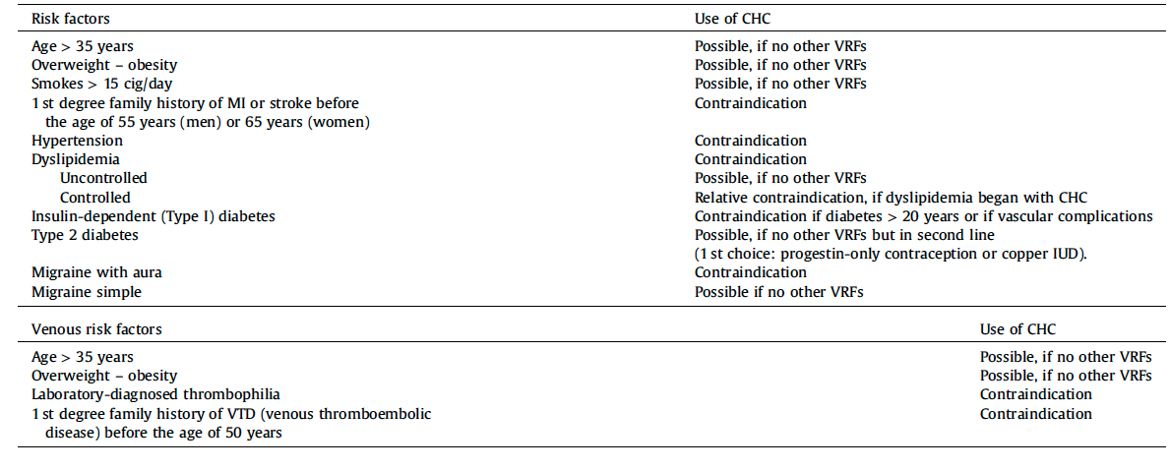
Screening all arterial and venous vascular risk factors for VTE ⁽¹⁾
Physicians should assess history and clinical examination for ALL VTE VASCULAR RISK FACTORS,
including family history, BEFORE MAKING ANY CHC PRESCRIPTIONS
Arterial or venous vascular risk factors (VRFs) and use of combined hormonal (oestrogen-progestin) contraception (CHC)
VTE: venous thromboembolic diseases – CHC: combined hormonal contraception
(1) Chabbert-Buffet N et al. Clinical practice guidelines for contraception of the French National College of Gynecologists and Obstetricians (CNGOF). J Gynecol Obstet Hum Reprod. 2019 Sep;48(7):441-454.

Slide 31
How to choose a hormonal contraceptive?
EXPERT OPINION
When 1 contraindication or 2 risk factors
=> choose a POP
When no androgenism
=> choose first a 2nd generation CHC 20 or 30 µg EE2
When androgenism
=> choose an NGM CHC
=> If the effect on hyperandrogenism is not sufficient, go to a 2nd or 3rd generation CHC
If dysmenorrhoea persists with a CHC with a monthly therapeutic window
=> change to a monophasic CHC with an extended regime
POP: progestin-only pill
CHC: combined hormonal contraceptives (CHC)
EE2: ethinyl estradiol
NGM: norgestimate (progestin)

Slide 32
HORMONE REPLACEMENT THERAPY (HRT) METHODS, BENEFITS, RISKS

Slide 33
MENOPAUSE: PHYSIOLOGICAL CHANGES
Menopause is the definitive stop of menstruations (amenorrhea) secondary to the CESSATION OF OVARIAN FUNCTION ⁽¹⁾
A retrospective diagnosis can be made in the presence
  of ELEVATED FSH
  or VASOMOTOR SYMPTOMS
in a woman after 12 months of AMENORRHEA ⁽¹⁾
Menopause occurs at a mean age of 51.5 years, with a wide range from
40 TO 58 YEARS of age ⁽¹⁾
Adapted from (1) Reid RL. Menopause. Chapter 64. In: Clinical Gynecology, Second edition. Published by Cambridge University Press. 2015. pp 985-1003.

Slide 34
MENOPAUSE: MANIFESTATIONS
The onset of menopause indicates a period of DIMINISHED OESTROGEN EXPOSURE,
which may have both ACUTE and CHRONIC effects on health and quality of life ⁽¹⁾
ACUTE OESTROGEN
DEFICIENCY SYMPTOMS ⁽¹⁾
CHRONIC OESTROGEN
DEFICIENCY SYMPTOMS ⁽¹⁾
CHRONIC AGING DEGENERATIVE DISEASES
with links to oestrogen deficiency ⁽¹⁾
Vasomotor flushes
= hot flashes
Night sweats, sleep disturbance
Palpitations
Headache
Irritability
Mood swings, depression
Urogenital atrophy with vaginal dryness
Dyspareunia
Vaginal itching or burning
Urinary frequency urgency, or nocturia
Skin aging
Osteoporosis: low bone mass, increased skeletal fragility with high fracture risk
Cardiovascular disease
Cognitive impairment
Cataracts
Macular degeneration
(1) Reid RL. Menopause. Chapter 64. In: Clinical Gynecology, Second edition. Published by Cambridge University Press. 2015. pp 985-1003.

Slide 35
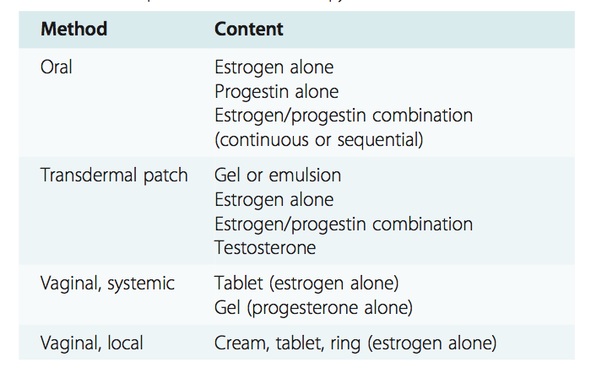
HRT: METHODS
Woman’s participation in the choice of delivery route is critical for ADHERENCE ⁽¹⁾
FOLLOW-UP is essential after 2 months, to provide reassurance and to determine if symptom control and bleeding are acceptable ⁽¹⁾
Duration of therapy will be determined by the need for ongoing symptom control to maintain QUALITY OF LIFE ⁽¹⁾
(1) Reid RL. Menopause. Chapter 64. In: Clinical Gynecology, Second edition. Published by Cambridge University Press. 2015. pp 985-1003.

Slide 36
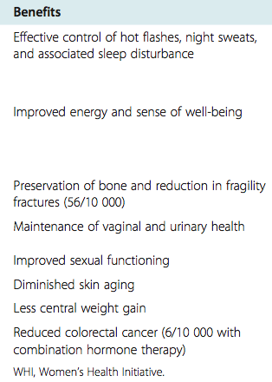
HRT: BENEFITS
Depending on the hormonal dose:
  Hot flushes, diffuse pains and vaginal dryness disappear
  Post-menopausal bone loss diminishes
  (decrease of bone resorption and hormone-dependent architectural alteration)
  Fracture risk decreases
Oestrogen therapy remains FIRST-LINE TREATMENT
for preventing bone loss and fractures
in symptomatic recently postmenopausal women ⁽¹⁾
Adapted from (1) Reid RL. Menopause. Chapter 64. In: Clinical Gynecology, Second edition. Published by Cambridge University Press. 2015. pp 985-1003.

Slide 37
HRT: RISKS
Two randomized placebo controlled studies (HERS* and WHI**) have shown increased risks with HRT in different populations:
  Women older than those who usually take HRT ⁽¹⁾
  Women with a cardiovascular risk (HERS) ⁽¹⁾
  Women with a uterus on oestroprogestin treatments (ECE), taking medroxyprogesterone acetate (MPA) ⁽²⁾
  Hysterectomized women on ECE only ⁽³⁾
* HERS: Heart and Estrogen/Progestin Replacement Study, ** WHI: Women’s Health Initiative Steering Committee: Writing Group
(1) Hulley S. et al. Randomized Trial of Estrogen Plus Progestin for Secondary Prevention of Coronary Heart Disease in Postmenopausal Women. JAMA 1998;280:605-613. ; (2) Chlebowski RT. et al. Influence of Estrogen Plus Progestin on Breast Cancer and Mammography in Healthy Postmenopausal Women The Women’s Health Initiative Randomized Trial. JAMA 2003;289:3243-3253. ; (3) Manson JE. et al. Menopausal Hormone Therapy and Health Outcomes During the Intervention and Extended Poststopping Phases of theWomen’s Health Initiative Randomized Trials. JAMA 2013;310(13):1353-1368.

Slide 38
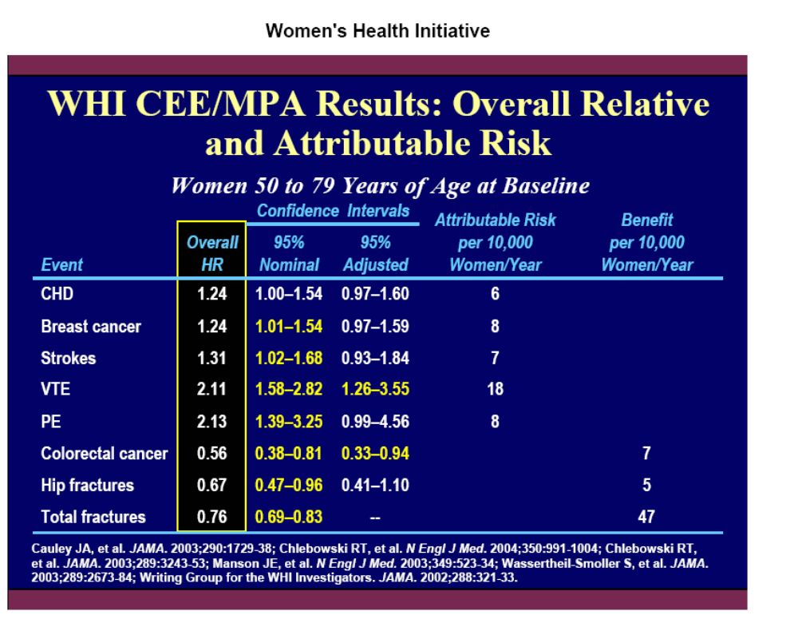
HRT: RISKS
WHI CEE/MPA results: overall relative and attribuable risk
Women 50 to 79 years of age at baseline ⁽¹⁻⁶⁾
CEE : Conjugated Equine Estrogens ; MPA : medroxyprogesterone acetate ; CHD: coronary heart disease, VTE: venous thromboembolism, PE: Pulmonary Embolism
(1) Cauley JA. et al. Effects of Estrogen Plus Progestin on Risk of Fracture and Bone Mineral Density The Women’s Health Initiative Randomized Trial. JAMA 2003;290:1729-1738. ; (2) Chlebowski RT. Et al. Estrogen plus Progestin and Colorectal Cancer in Postmenopausal Women. N Engl J Med 2004;350:991-1004. ; (3) Chlebowski RT. et al. Influence of Estrogen Plus Progestin on Breast Cancer and Mammography in Healthy Postmenopausal Women The Women’s Health Initiative Randomized Trial. JAMA 2003;289:3243-3253. ; (4) Manson JE et al. Estrogen plus Progestin and the Risk of Coronary Heart Disease. N Engl J Med 2003;349:523-34. ; (5) Wassertheil-Smoller S. et al. Effect of Estrogen Plus Progestin on Stroke in Postmenopausal Women The Women’s Health Initiative: A Randomized Trial. JAMA 2003;289:2673-2684. ; (6) Writing Group for the Women’s Health Initiative Investigators. Risks and Benefits of Estrogen Plus Progestin in Healthy Postmenopausal Women Principal Results From the Women’s Health Initiative Randomized Controlled Trial. JAMA 2002;288:321-333.

Slide 39
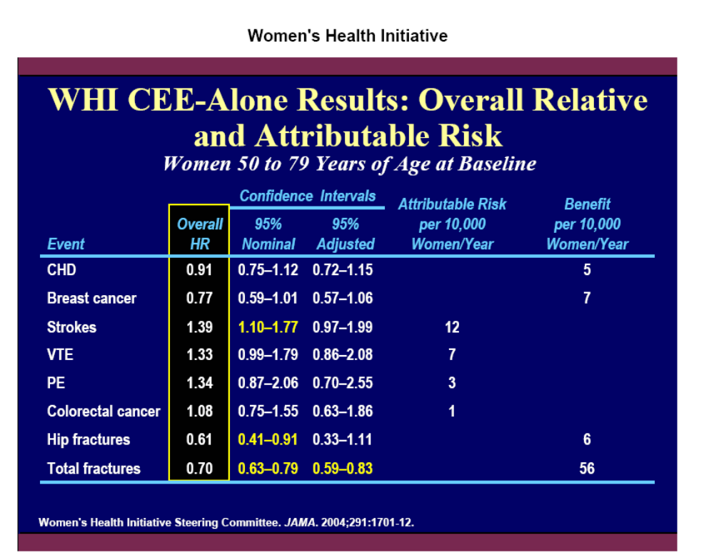
HRT: RISKS
WHI CEE/alone results: overall relative and attribuable risk
Women 50 to 79 years of age at baseline ⁽¹⁾
CEE : Conjugated Equine Estrogens ; CHD: coronary heart disease, VTE: venous thromboembolism, PE: Pulmonary Embolism
(1) Adapted from: The Women’s Health Initiative Randomized Controlled Trial. Effects of Conjugated Equine Estrogen in Postmenopausal Women With Hysterectomy. JAMA. 2004;291:1701-12.

Slide 40
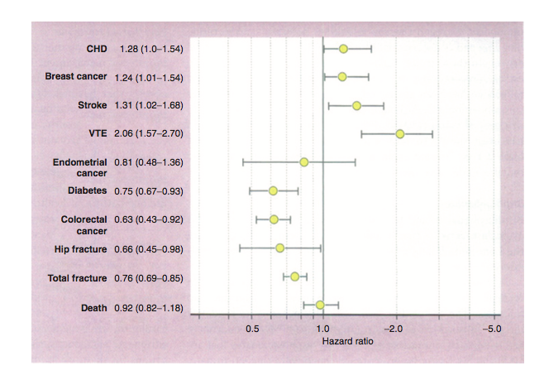
HRT: RISKS
FOCUS ON CORONARY RISK
HRT (combined or oestrogen-only) does
NOT PROTECT AGAINST CORONARY DISEASE
in women with or without a history of
cardiovascular disease ⁽¹⁾
There is an INCREASED RISK of coronary
disease on combined HRT, apparently
unrelated to treatment duration ⁽¹⁾
In women with a low risk of cardiovascular
disease, this increase DOES NOT JUSTIFY not
prescribing or discontinuing HRT, if the anticipated benefits of treatment are high ⁽¹⁾
Adapted from WHI (2) - randomized clinical trial comparing continuous combined estrogen/progestin with placebo
(1) ANAES. AFSSAPS. Hormone replacement therapy at menopause. 2004 ; (2) Reid RL. Menopause. Chapter 64. In: Clinical Gynecology, Second edition. Published by Cambridge University Press. 2015. pp 985-1003.

Slide 41
HRT: RISKS
FOCUS ON STROKE
Adapted from WHI (1) - randomized clinical trial comparing continuous combined estrogen/progestin with placebo
Annual risk of stroke increases from
<1 in 1000 at the time of menopause to
10 in 1000 by 75 years of age ⁽¹⁾
The WHI reported an overall small increase
in the incidence of non-fatal ischaemic
stroke in women started on HRT, regardless
of age at initiation ⁽¹⁾
It is possible that transdermal oestrogens only or
associated with progestin might not increase the risk, but this is according to one observational study ⁽²⁾
(1) Reid RL. Menopause. Chapter 64. In: Clinical Gynecology, Second edition. Published by Cambridge University Press. 2015. pp 985-1003. ;
(2) Renoux C et al. Transdermal and oral hormone replacement therapy and the risk of stroke: a nested case-control study. BMJ 2010;340:c2519.

Slide 42
HORMONE REPLACEMENT THERAPY (HRT)
RISK OF VTE

Slide 43
HRT & RISK OF VTE
WHAT IS THE RISK?
VTE increases with advancing age, being around 1.0 event/1000 person-years in those aged 41–77 years and 10 events/1000 person-years in those over 75 years ⁽¹⁾
Oral HRT, either combined oestrogen–progestin or oestrogen alone, results in a
2 to 4 fold increased relative risk of developing VTE ⁽¹⁾
Limited data suggest that transdermal HRT may be associated with lower rates of VTE
(observational ESTHER Study) ⁽²⁾
Adapted from WHI (1) - randomized clinical trial comparing continuous combined oestrogen/progestin with placebo
VTE: venous thromboembolism
(1) Reid RL. Menopause. Chapter 64. In: Clinical Gynecology, Second edition. Published by Cambridge University Press. 2015. pp 985-1003. ; (2) Scarabin PY et al. Differential association of oral and transdermal oestrogen- replacement therapy with venous thromboembolism risk. Lancet 2003 362: 428–32.

Slide 44
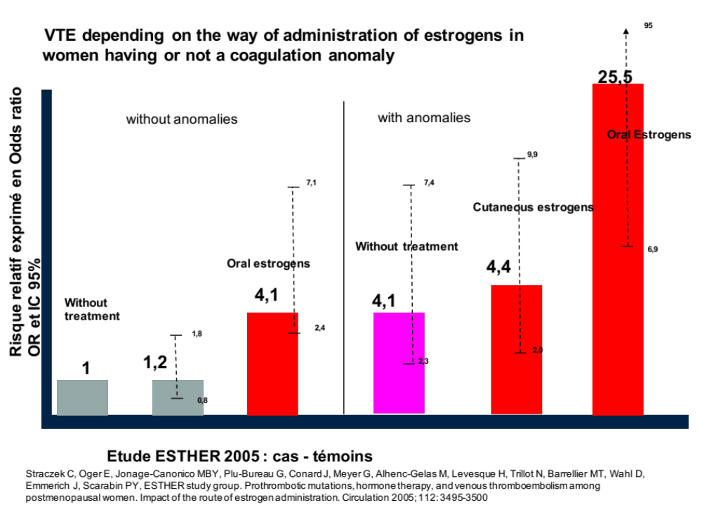
HRT & RISK OF VTE
IMPACT OF THE ROUTE OF ADMINISTRATION
VTE depends on the route of administration of oestrogens in women with or without coagulation anomalies (ESTHER study) ⁽¹⁾
Relative risk as Odds Ratio (OR and IC 95%)
(1) Straczek C. et al. Prothrombotic Mutations, Hormone Therapy, and Venous Thromboembolism Among Postmenopausal Women Impact of the Route of Estrogen Administration. Circulation. 2005;112:3495-3500.

Slide 45
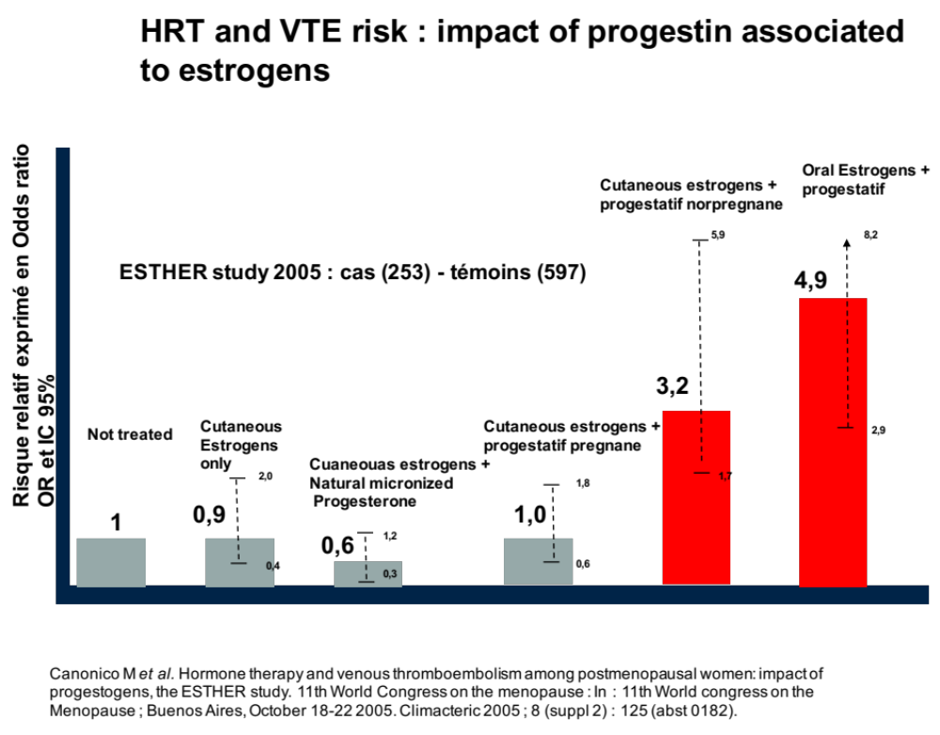
HRT & RISK OF VTE
IMPACT OF PROGESTIN
HRT and VTE risk: impact of progestin associated with oestrogens (ESTHER study) ⁽¹⁾
Relative risk as Odds Ratio (OR and IC 95%)
Cutaneous
Adapted from (1) Canonico M. et al. Hormone Therapy and Venous Thromboembolism Among Postmenopausal Women Impact of the Route of Estrogen Administration and Progestogens: The ESTHER Study. Circulation 2007;115:840-845.
Notes:
REMARQUE: Les chiffres présentés sur le graphique ne correspondent pas tout à fait aux chiffres mentionnés dans la publication. Le graphe a peut être été extrait d’un Abstract ?

Slide 46
CONCLUSIONS
HRT is effective in treating the climacteric syndrome ⁽¹⁾
HRT has important secondary effects, with a increased risks of:
  Coronary disease
  Stroke (if oral oestrogens)? ⁽⁴⁾
  VTE when oral oestrogens are used aggravated by artificial progestins ⁽²⁾
  Not detailed in the presentation
    Endometrium cancer when there is no progestin added to oestrogens ⁽³⁾
    Breast cancer, if artificial progestins are used ⁽¹⁾
(1) Reid RL. Menopause. Chapter 64. In: Clinical Gynecology, Second edition. Published by Cambridge University Press. 2015. pp 985-1003. ; (2) Straczek C. et al. Prothrombotic Mutations, Hormone Therapy, and Venous Thromboembolism Among Postmenopausal Women Impact of the Route of Estrogen Administration. Circulation 2005;112:3495-3500 ; (3) Weiderpass E. et al. Risk of Endometrial Cancer Following Estrogen Replacement With and Without Progestins. JNCI 1999;91:1131-37 ; (4) Wassertheil-Smoller S. et al. Effect of Estrogen Plus Progestin on Stroke in Postmenopausal Women The Women’s Health Initiative: A Randomized Trial. JAMA 2003;289:2673-2684.

